Slide 1

Fundamentals of Python:
First Programs
Chapter 8: Design
with Classes

Slide 2

Objectives
After completing this chapter, you will be able to:
Determine the attributes and behavior of a class of objects required by a program
List the methods, including their parameters and return types, that realize the behavior of a class of objects
Choose the appropriate data structures to represent the attributes of a class of objects
Define a constructor, instance variables, and methods for a class of objects
Fundamentals of Python: First Programs

Slide 3
Objectives (continued)
Recognize the need for a class variable
Define a method that returns the string representation of an object
Define methods for object equality and comparisons
Exploit inheritance and polymorphism when developing classes
Transfer objects to and from files
Fundamentals of Python: First Programs

Slide 4
Getting Inside Objects and Classes
Programmers who use objects and classes know:
  Interface that can be used with a class
  State of an object
  How to instantiate a class to obtain an object
Objects are abstractions
  Package their state and methods in a single entity that can be referenced with a name
Class definition is like a blueprint for each of the objects of that class
Fundamentals of Python: First Programs

Slide 5
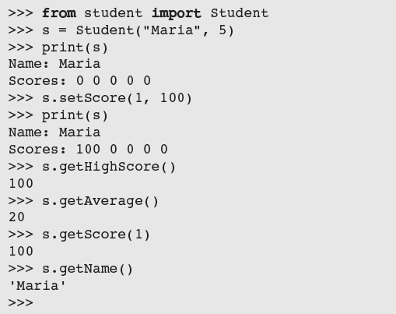
A First Example: The Student Class
A course-management application needs to represent information about students in a course
Fundamentals of Python: First Programs

Slide 6
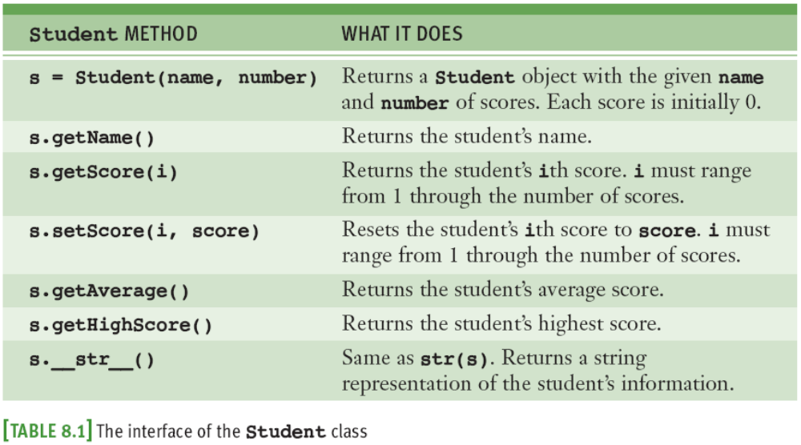
The Student Class (continued)
Fundamentals of Python: First Programs

Slide 7
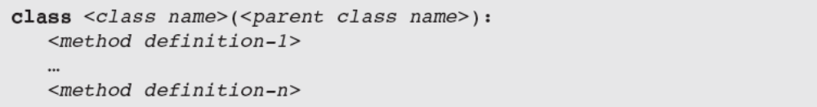
The Student Class (continued)
Syntax of a simple class definition:
  Class name is a Python identifier
    Typically capitalized
Python classes are organized in a tree-like class hierarchy
  At the top, or root, of this tree is the object class
  Some terminology: subclass, parent class
← class header
Fundamentals of Python: First Programs

Slide 8
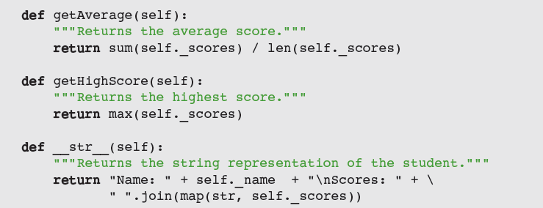
The Student Class (continued)
Fundamentals of Python: First Programs

Slide 9
Docstrings
Docstrings can appear at three levels:
  Module
  Just after class header
    To describe its purpose
  After each method header
    Serve same role as they do for function definitions
help(Student) prints the documentation for the class and all of its methods
Fundamentals of Python: First Programs

Slide 10
Method Definitions
Method definitions are indented below class header
Syntax of method definitions similar to functions
  Can have required and/or default arguments, return values, create/use temporary variables
  Returns None when no return statement is used
Each method definition must include a first parameter named self
Example: s.getScore(4)
  Binds the parameter self in the method getScore to the Student object referenced by the variable s
Fundamentals of Python: First Programs

Slide 11
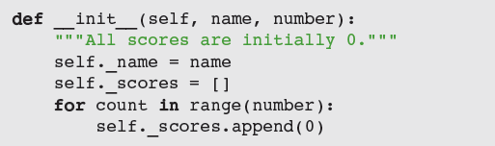
The __init__ Method and Instance Variables
Most classes include the __init__ method
  Class’s constructor
  Runs automatically when user instantiates the class
Example: s = Student("Juan", 5)
Instance variables represent object attributes
  Serve as storage for object state
  Scope is the entire class definition
Fundamentals of Python: First Programs

Slide 12
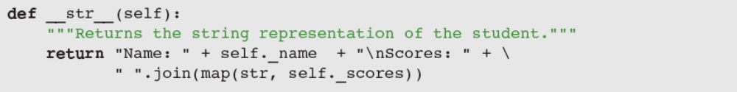
The __str__ Method
Classes usually include an __str__ method
  Builds and returns a string representation of an object’s state
When str function is called with an object, that object’s __str__ method is automatically invoked
Perhaps the most important use of __str__ is in debugging
Fundamentals of Python: First Programs

Slide 13
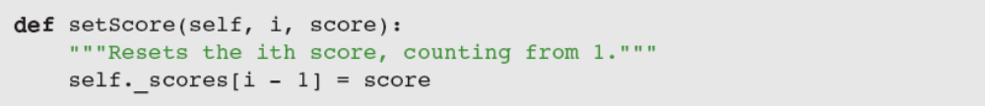
Accessors and Mutators
Methods that allow a user to observe but not change the state of an object are called accessors
Methods that allow a user to modify an object’s state are called mutators
Tip: if there’s no need to modify an attribute (e.g., a student’s name), do not include a method to do that
Fundamentals of Python: First Programs

Slide 14
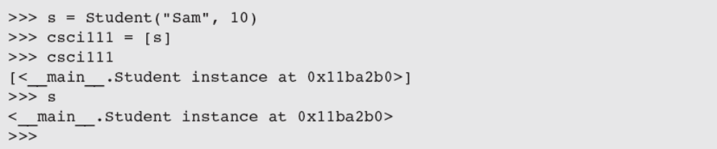
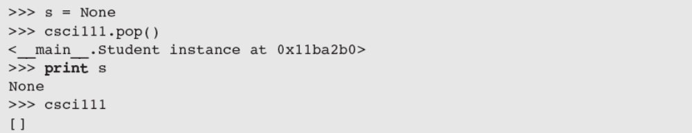
The Lifetime of Objects
The lifetime of an object’s instance variables is the lifetime of that object
An object becomes a candidate for the graveyard when it can no longer be referenced
Student object still exists, but interpreter will recycle its storage during garbage collection
Fundamentals of Python: First Programs

Slide 15
Rules of Thumb for Defining a Simple Class
Before writing a line of code, think about the behavior and attributes of the objects of new class
Choose an appropriate class name and develop a short list of the methods available to users
Write a short script that appears to use the new class in an appropriate way
Choose appropriate data structures for attributes
Fill in class template with __init__ and __str__
Complete and test remaining methods incrementally
Document your code
Fundamentals of Python: First Programs

Slide 16
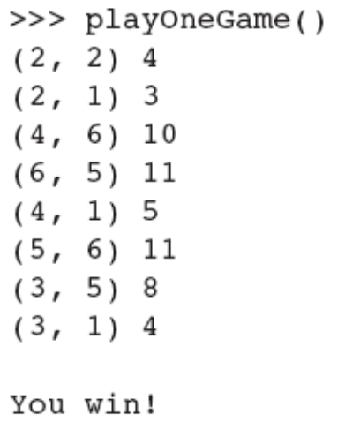
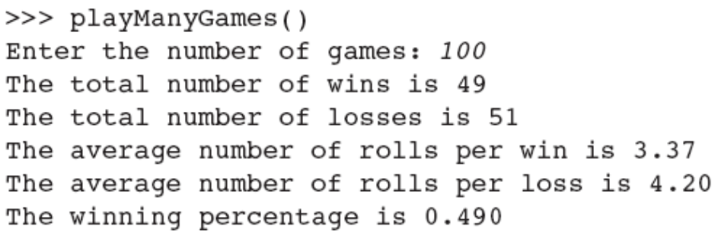
Case Study: Playing the Game of Craps
Request:
  Write a program that allows the user to play and study the game of craps
Analysis: define Player and Die classes
  User interface: prompt for number of games to play
Fundamentals of Python: First Programs

Slide 17
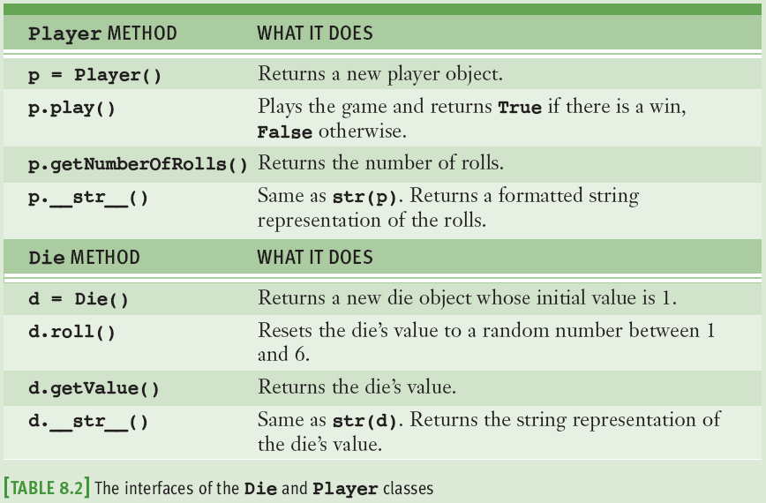
Case Study: Design
Fundamentals of Python: First Programs

Slide 18
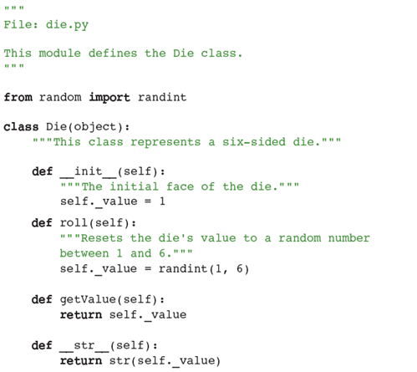
Case Study: Implementation (Coding)
Fundamentals of Python: First Programs

Slide 19
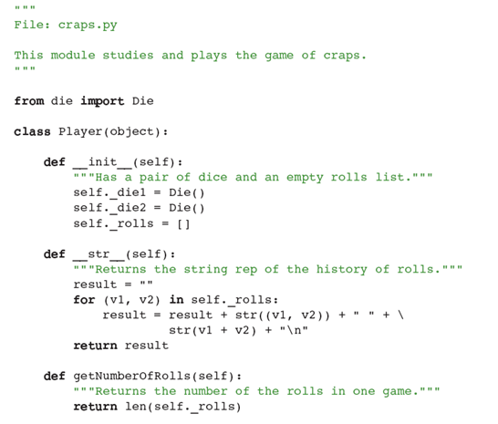
Case Study: Implementation (Coding) (continued)
Fundamentals of Python: First Programs

Slide 20
Data-Modeling Examples
As you have seen, objects and classes are useful for modeling objects in the real world
In this section, we explore several other examples
Fundamentals of Python: First Programs

Slide 21
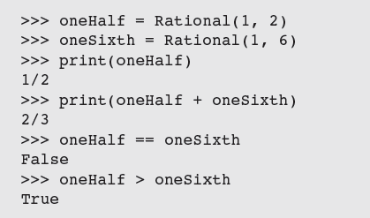
Rational Numbers
Rational number consists of two integer parts, a numerator and a denominator
  Examples: 1/2, 2/3, etc.
Python has no built-in type for rational numbers
  We will build a new class named Rational
Operators need to be overloaded
Fundamentals of Python: First Programs

Slide 22
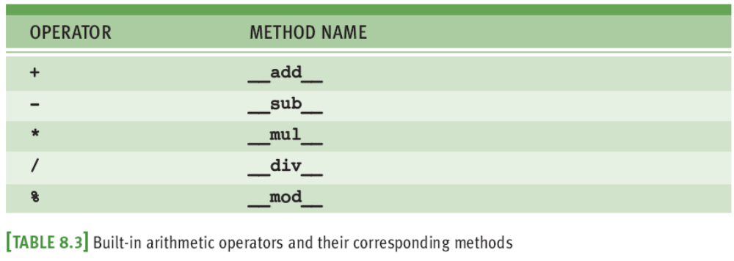
Rational Number Arithmetic and Operator Overloading
Object on which the method is called corresponds to the left operand
  For example, the code x + y is actually shorthand for the code x.__add__(y)
Fundamentals of Python: First Programs

Slide 23
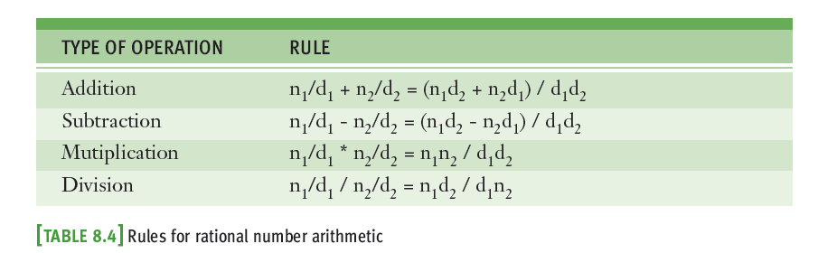
Rational Number Arithmetic and Operator Overloading (continued)
To overload an arithmetic operator, you define a new method using the appropriate method name
Code for each method applies a rule of rational number arithmetic
Fundamentals of Python: First Programs

Slide 24
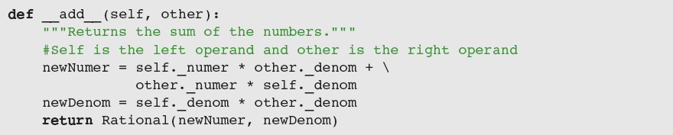
Rational Number Arithmetic and Operator Overloading (continued)
Operator overloading is another example of an abstraction mechanism
  We can use operators with single, standard meanings even though the underlying operations vary from data type to data type
Fundamentals of Python: First Programs

Slide 25
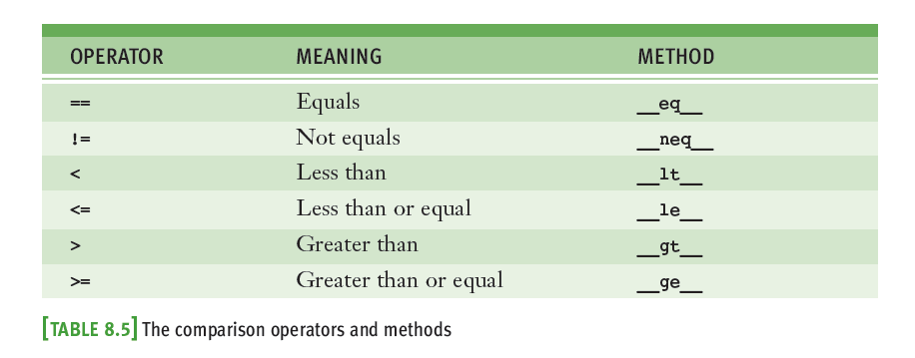
Comparison Methods
Fundamentals of Python: First Programs

Slide 26
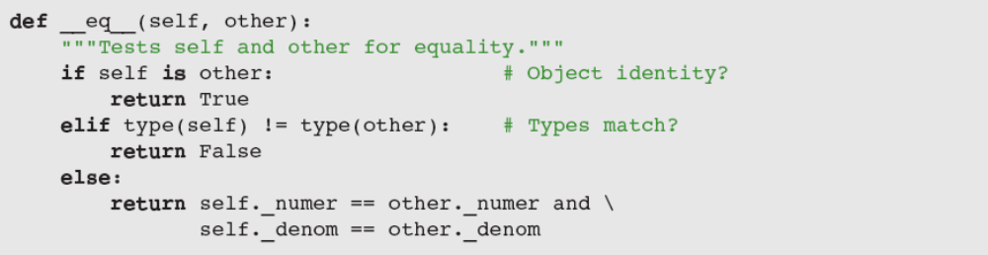
Equality and the __eq__ Method
Not all objects are comparable using < or >, but any two objects can be compared for == or !=
  twoThirds < "hi there" should generate an error
  twoThirds != "hi there" should return True
Include __eq__ in any class where a comparison for equality uses a criterion other than object identity
Fundamentals of Python: First Programs

Slide 27
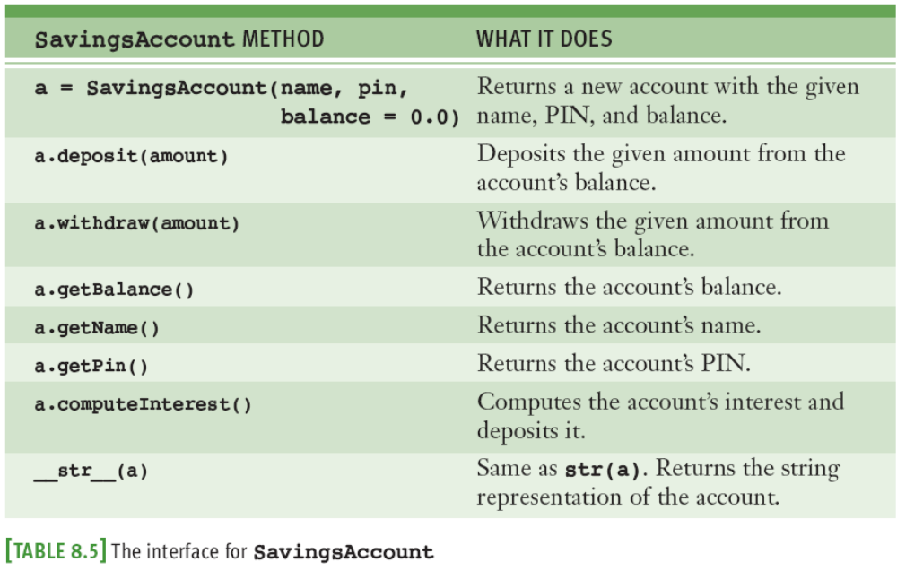
Savings Accounts and Class Variables
Fundamentals of Python: First Programs

Slide 28
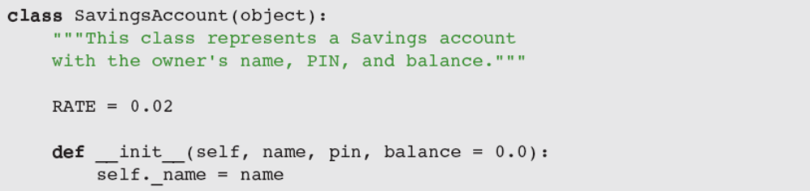
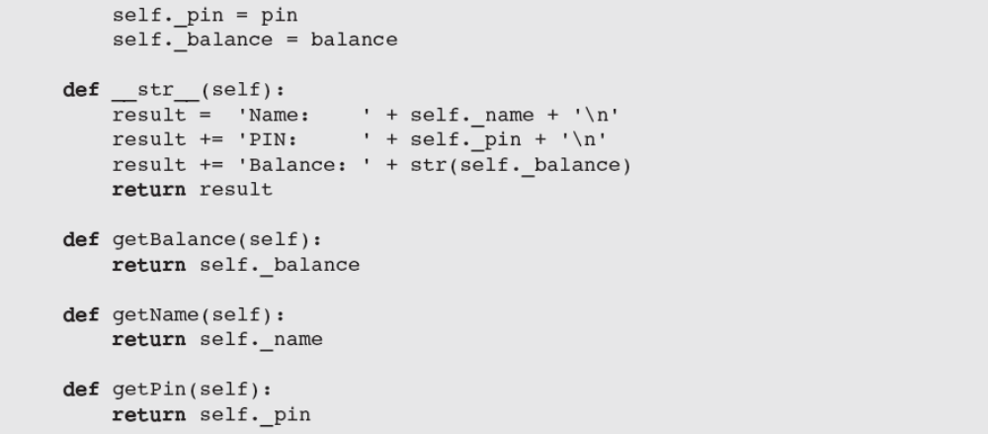
Savings Accounts and Class Variables (continued)
Fundamentals of Python: First Programs

Slide 29
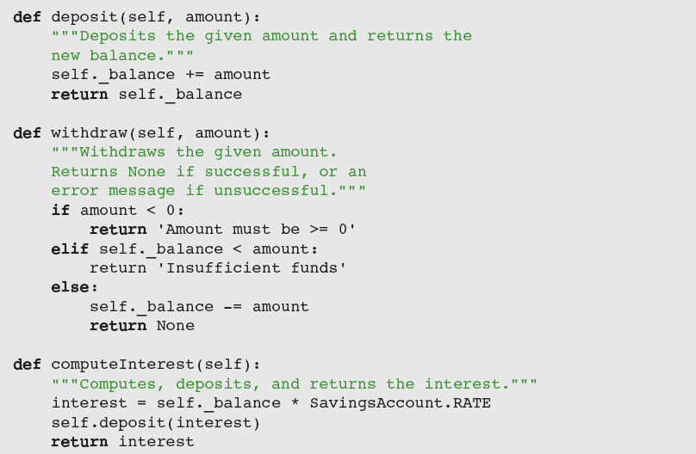
Savings Accounts and Class Variables (continued)
Fundamentals of Python: First Programs

Slide 30
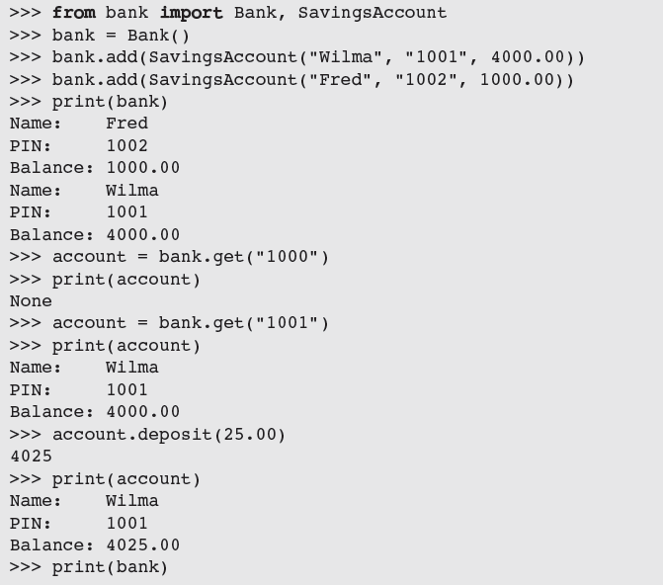
Putting the Accounts into a Bank
Fundamentals of Python: First Programs

Slide 31
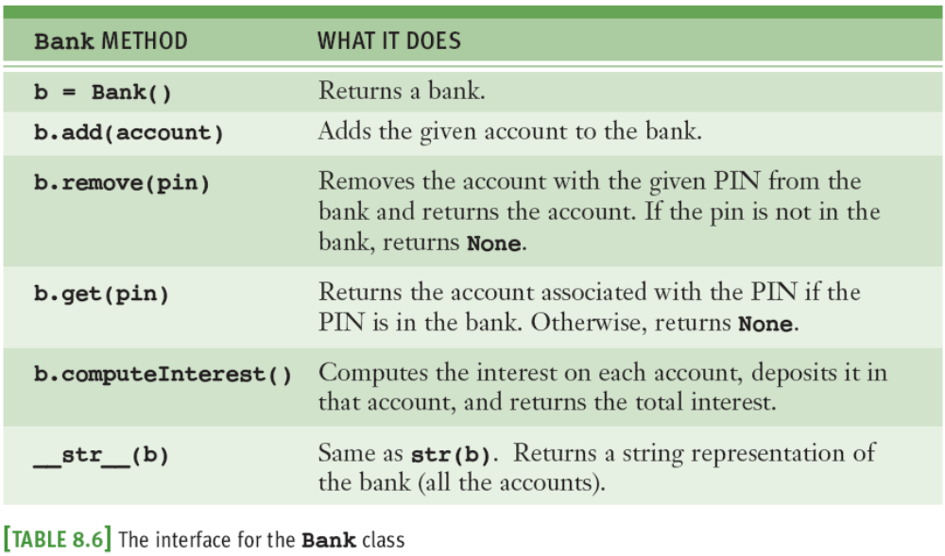
Putting the Accounts into a Bank (continued)
Fundamentals of Python: First Programs

Slide 32
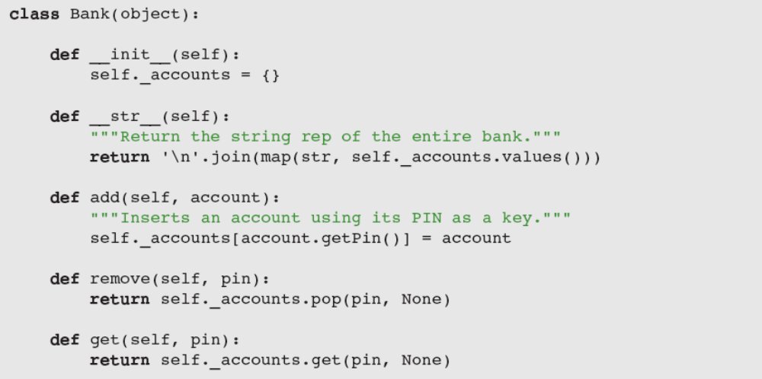
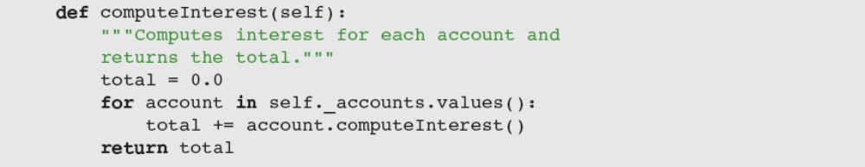
Putting the Accounts into a Bank (continued)
Fundamentals of Python: First Programs

Slide 33
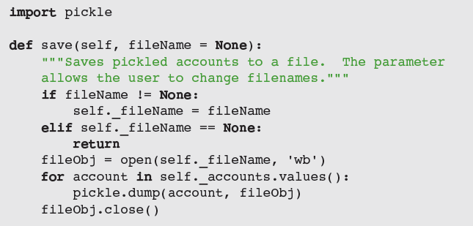
Using pickle for Permanent Storage of Objects
pickle allows programmer to save and load objects using a process called pickling
  Python takes care of all of the conversion details
Fundamentals of Python: First Programs

Slide 34
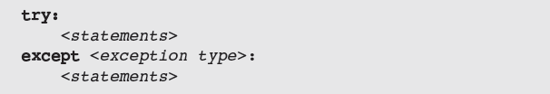
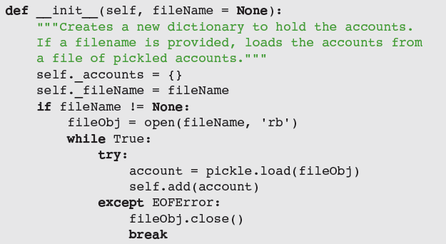
Input of Objects and the try-except Statement
Fundamentals of Python: First Programs

Slide 35
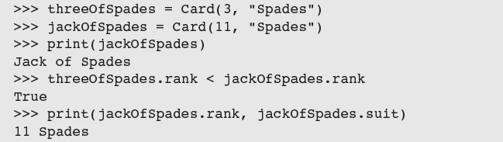
Playing Cards
Use of the Card class:
Because the attributes are only accessed and never modified, we do not include any methods other than __str__ for string representation
A card is little more than a container of two data values
Fundamentals of Python: First Programs

Slide 36
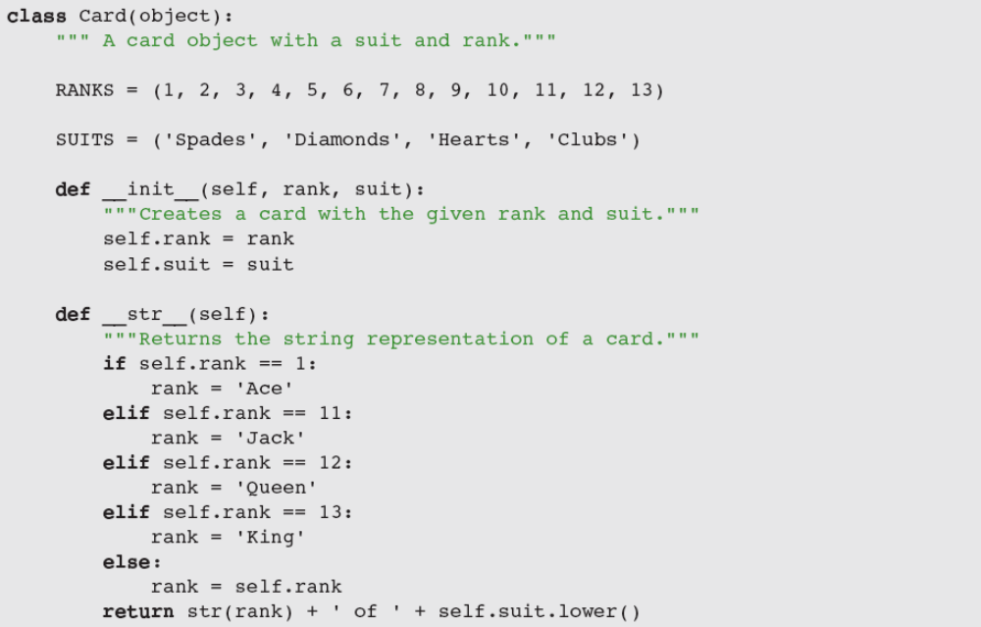
Playing Cards (continued)
Fundamentals of Python: First Programs

Slide 37
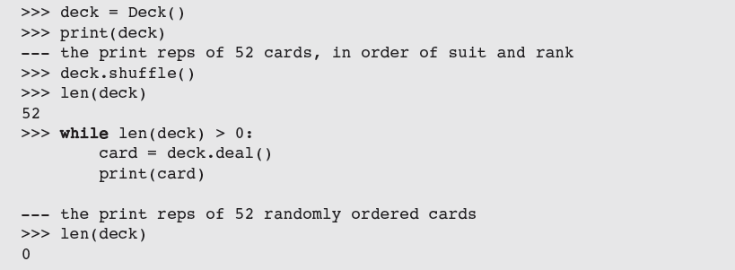
Playing Cards (continued)
Unlike an individual card, a deck has significant behavior that can be specified in an interface
One can shuffle the deck, deal a card, and determine the number of cards left in it
Fundamentals of Python: First Programs

Slide 38
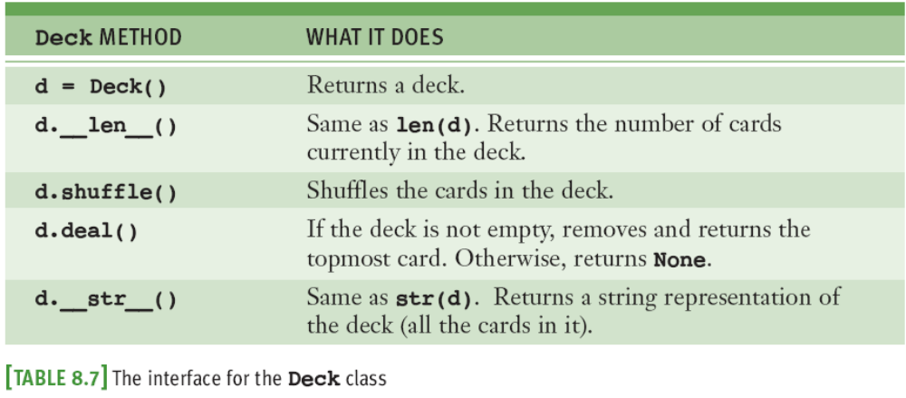
Playing Cards (continued)
During instantiation, all 52 unique cards are created and inserted into a deck’s internal list
Fundamentals of Python: First Programs

Slide 39
Case Study: An ATM
Develop a simple ATM program that uses the Bank and SavingsAccount classes
Request:
  Write a program that simulates a simple ATM
Analysis:
  Class diagram in Figure 8.2 shows the relationships among the classes
    Name of each class appears in a box
    Edges connecting the boxes show the relationships
  Use model/view pattern to structure the code
Fundamentals of Python: First Programs

Slide 40
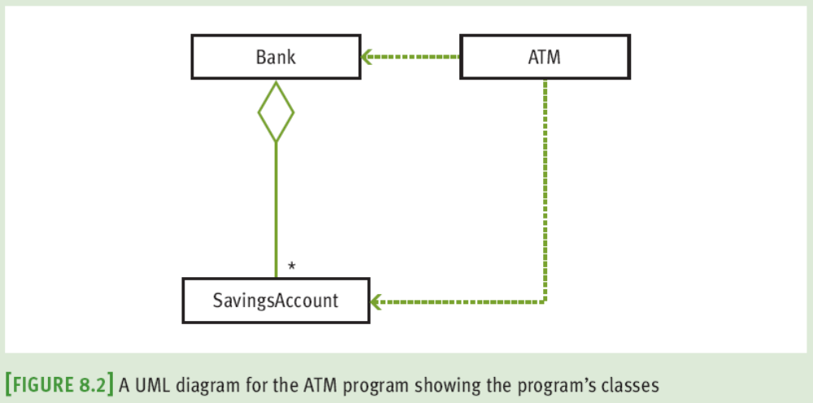
Case Study: An ATM (continued)
Fundamentals of Python: First Programs

Slide 41
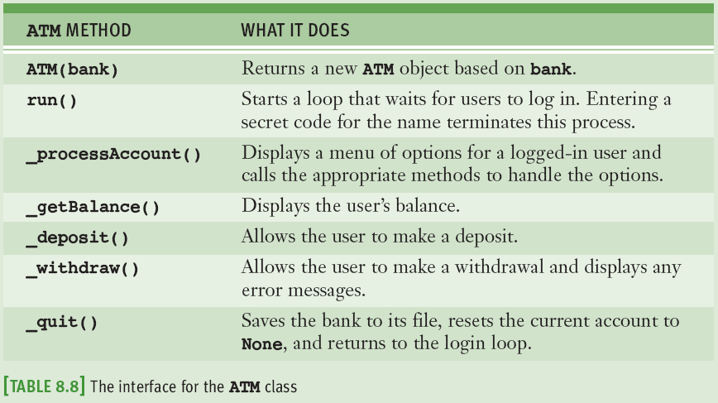
Case Study: An ATM (continued)
Design
Fundamentals of Python: First Programs

Slide 42
Structuring Classes with Inheritance and Polymorphism
Most object-oriented languages require the programmer to master the following techniques:
  Data encapsulation: Restricting manipulation of an object’s state by external users to a set of method calls
  Inheritance: Allowing a class to automatically reuse/ and extend code of similar but more general classes
  Polymorphism: Allowing several different classes to use the same general method names
Python’s syntax doesn’t enforce data encapsulation
Inheritance and polymorphism are built into Python
Fundamentals of Python: First Programs

Slide 43
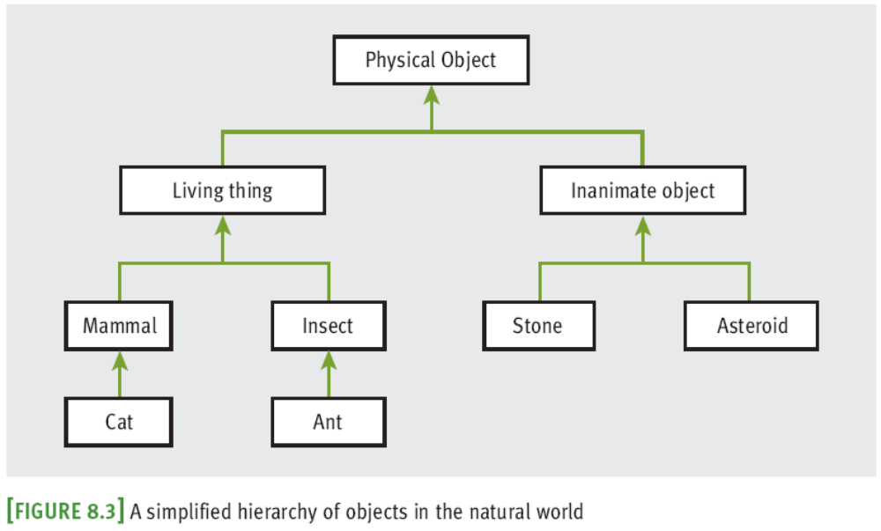
Inheritance Hierarchies and Modeling
Fundamentals of Python: First Programs

Slide 44
Inheritance Hierarchies and Modeling (continued)
In Python, all classes automatically extend the built-in object class
It is possible to extend any existing class:
Example:
  PhysicalObject would extend object
  LivingThing would extend PhysicalObject
Inheritance hierarchies provide an abstraction mechanism that allows the programmer to avoid reinventing the wheel or writing redundant code
Fundamentals of Python: First Programs

Slide 45
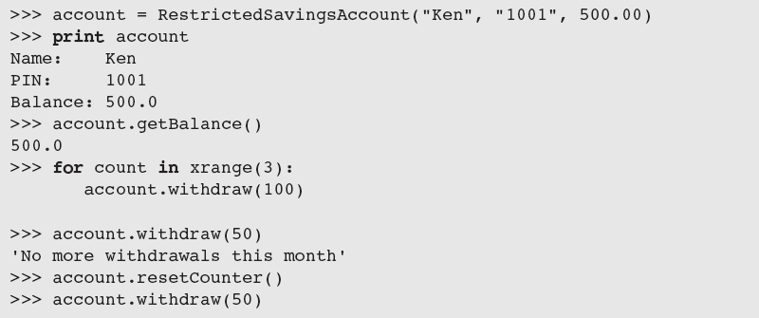
Example: A Restricted Savings Account
To call a method in the parent class from within a method with the same name in a subclass:
A RestrictedSavingsAccount permits up to three withdrawals
Fundamentals of Python: First Programs

Slide 46
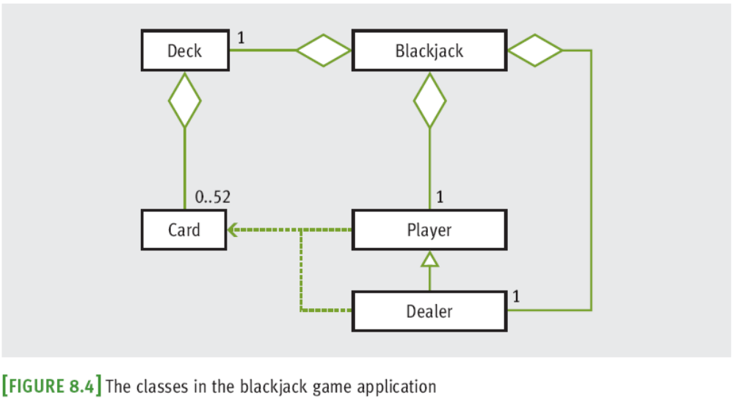
Example: The Dealer and a Player in the Game of Blackjack
Fundamentals of Python: First Programs

Slide 47
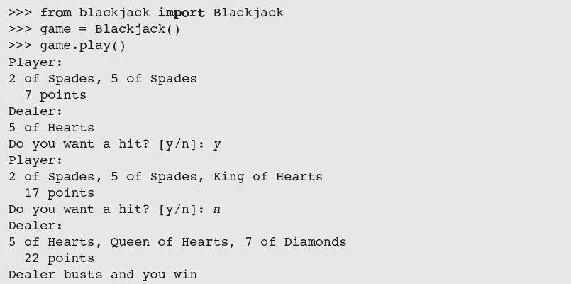
Example: Blackjack (continued)
An object belonging to Blackjack class sets up the game and manages the interactions with user
Fundamentals of Python: First Programs

Slide 48
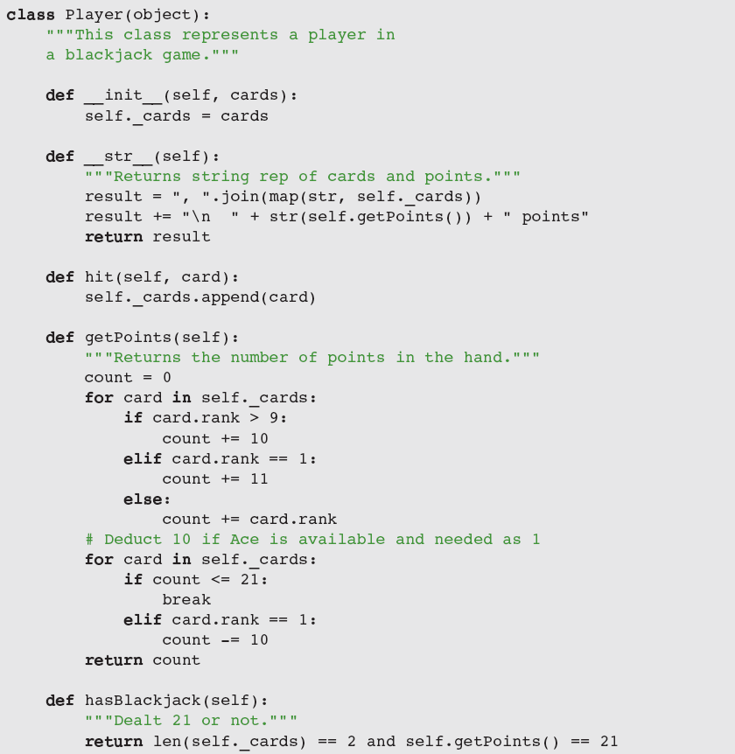
Example: Blackjack (continued)
Fundamentals of Python: First Programs

Slide 49
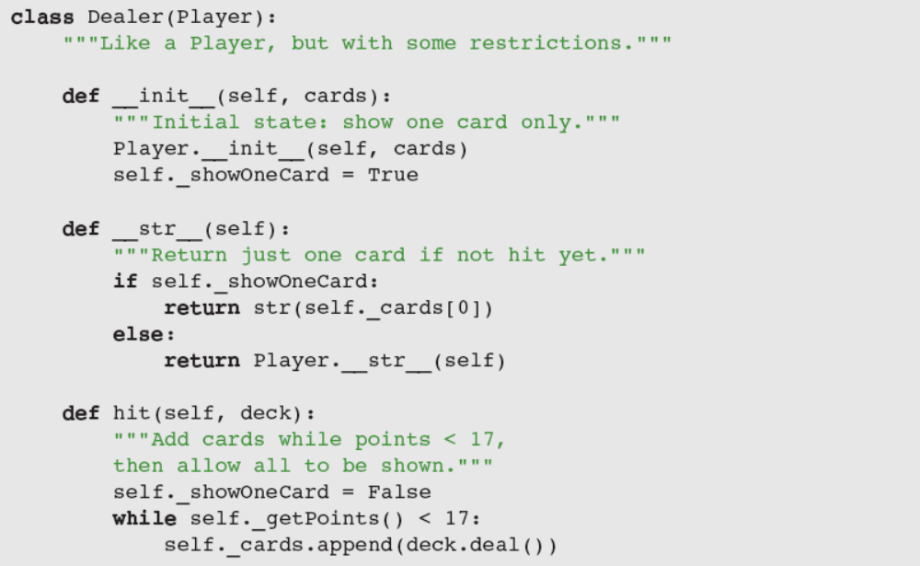
Example: Blackjack (continued)
Fundamentals of Python: First Programs

Slide 50
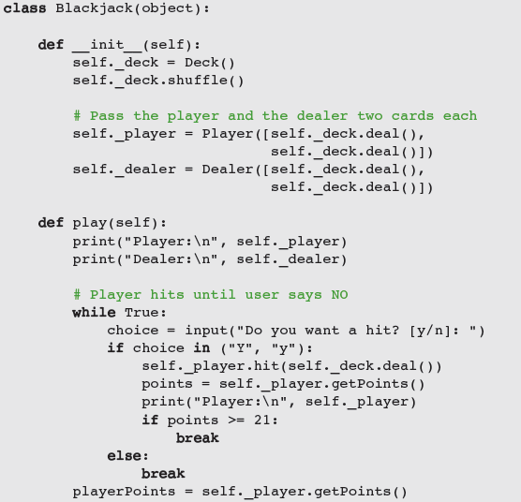
Example: Blackjack (continued)
Fundamentals of Python: First Programs

Slide 51
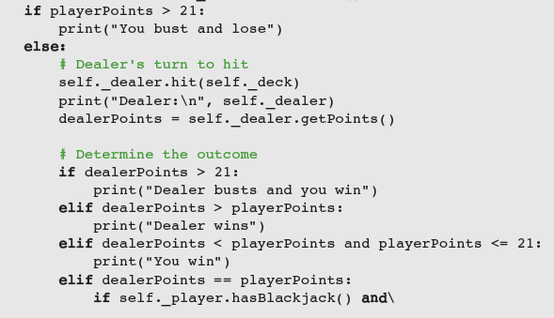
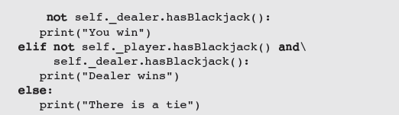
Example: Blackjack (continued)
Fundamentals of Python: First Programs

Slide 52
Polymorphic Methods
We subclass when two classes share a substantial amount of abstract behavior
  The classes have similar sets of methods/operations
  A subclass usually adds something extra
The two classes may have the same interface
  One or more methods in subclass override the definitions of the same methods in the superclass to provide specialized versions of the abstract behavior
    Polymorphic methods (e.g., the __str__ method)
Fundamentals of Python: First Programs

Slide 53
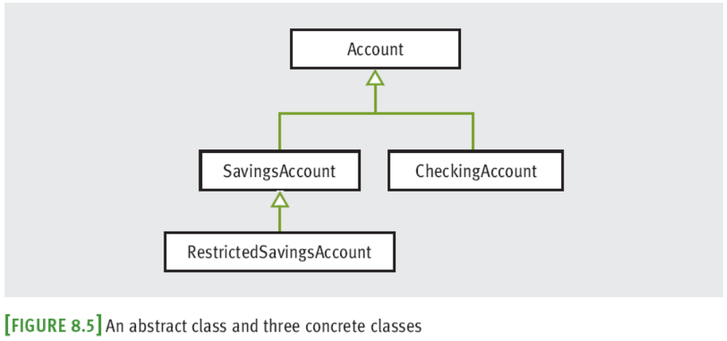
Abstract Classes
An abstract class includes data and methods common to its subclasses, but is never instantiated
Fundamentals of Python: First Programs

Slide 54
The Costs and Benefits of Object-Oriented Programming
Imperative programming
  Code consists of I/O, assignment, and control (selection/iteration) statements
  Does not scale well
Improvement: Embedding sequences of imperative code in function definitions or subprograms
  Procedural programming
Functional programming views a program as a set of cooperating functions
  No assignment statements
Fundamentals of Python: First Programs

Slide 55
The Costs and Benefits of Object-Oriented Programming (continued)
Functional programming does not conveniently model situations where data must change state
Object-oriented programming attempts to control the complexity of a program while still modeling data that change their state
  Divides up data into units called objects
  Well-designed objects decrease likelihood that system will break when changes are made within a component
  Can be overused and abused
Fundamentals of Python: First Programs

Slide 56
Summary
A simple class definition consists of a header and a set of method definitions
In addition to methods, a class can also include instance variables
Constructor or __init__ method is called when a class is instantiated
A method contains a header and a body
An instance variable is introduced and referenced like any other variable, but is always prefixed with self
Fundamentals of Python: First Programs

Slide 57
Summary (continued)
Some standard operators can be overloaded for use with new classes of objects
When a program can no longer reference an object, it is considered dead and its storage is recycled by the garbage collector
A class variable is a name for a value that all instances of a class share in common
Pickling is the process of converting an object to a form that can be saved to permanent file storage
try-except statement is used to catch and handle exceptions
Fundamentals of Python: First Programs

Slide 58
Summary (continued)
Most important features of OO programming: encapsulation, inheritance, and polymorphism
  Encapsulation restricts access to an object’s data to users of the methods of its class
  Inheritance allows one class to pick up the attributes and behavior of another class for free
  Polymorphism allows methods in several different classes to have the same headers
A data model is a set of classes that are responsible for managing the data of a program
Fundamentals of Python: First Programs

